Slide 1
Clinical Data Science Specialization Clinical Data Models and Common Data Models Module 5 Programming Assignment ETL MIMIC data into the OMOP CONDITION_OCCURRENCE table
Juan Francisco Velázquez Vadillo
March 25th, 2023

Slide 2
ETL MIMIC data into the OMOP CONDITION_OCCURRENCE table
ETL Steps
Understand source/target data models
Profile source tables
Create ETL mappings
Write transformation code
Execute transformation
Perform data quality assessment
Package documentation
Notes:
This is an overview of the seven steps for ETL. The assignment focuses on Steps 1 thru 4 and Step 6
Place your finished deliverables into one or more slides. Add notes to provide additional information/context about what you have done

Slide 3
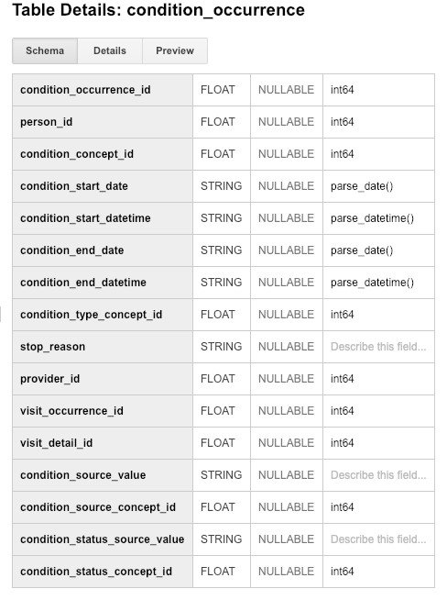
Step 1: Understand source/target data models
CONDITION_OCCURRENCE is the
TARGET OMOP table.
Read the OMOP documentation about the type of data stored in CONDITION_OCCURRENCE and for three fields below that are in that table:
person_id
visit_occurrence_id
condition_source_value
Notes:
Paste into one or more slides, the key table or tables from MIMIC that hold data that can be used to fill in the OMOP CONDITION_OCCURRENCE table.
Choose the MIMIC table screenshots from this slide to indicate which MIMIC table or tables would be used in the ETL process. Delete the MIMIC tables that you will not use.

Slide 4
http://ohdsi.github.io/CommonDataModel/cdm54.html
OMOP CONDITION_OCCURRENCE table
Table Description:
This table contains records of Events of a Person suggesting the presence of a disease or medical condition stated as a diagnosis, a sign, or a symptom, which is either observed by a Provider or reported by the patient.

Slide 5
http://ohdsi.github.io/CommonDataModel/cdm54.html
OMOP CONDITION_OCCURRENCE table
User Guidance:
Conditions are defined by Concepts from the Condition domain, which form a complex hierarchy. As a result, the same Person with the same disease may have multiple Condition records, which belong to the same hierarchical family. Most Condition records are mapped from diagnostic codes, but recorded signs, symptoms and summary descriptions also contribute to this table. Rule out diagnoses should not be recorded in this table, but in reality their negating nature is not always captured in the source data, and other precautions must be taken when identifying Persons who should suffer from the recorded Condition. Record all conditions as they exist in the source data. Any decisions about diagnosis/phenotype definitions would be done through cohort specifications. These cohorts can be housed in the COHORT table.

Slide 6
http://ohdsi.github.io/CommonDataModel/cdm54.html
OMOP CONDITION_OCCURRENCE table
User Guidance: continued
Conditions span a time interval from start to end, but are typically recorded as single snapshot records with no end date. The reason is twofold: (i) At the time of the recording the duration is not known and later not recorded, and (ii) the Persons typically cease interacting with the healthcare system when they feel better, which leads to incomplete capture of resolved Conditions. The CONDITION_ERA table addresses this issue. Family history and past diagnoses (�history of�) are not recorded in this table. Instead, they are listed in the OBSERVATION table. Codes written in the process of establishing the diagnosis, such as �question of� of and �rule out�, should not represented here. Instead, they should be recorded in the OBSERVATION table, if they are used for analyses. However, this information is not always available.

Slide 7
http://ohdsi.github.io/CommonDataModel/cdm54.html
OMOP CONDITION_OCCURRENCE table
ETL Conventions:
Source codes and source text fields mapped to Standard Concepts of the Condition Domain have to be recorded here.

Slide 8
http://ohdsi.github.io/CommonDataModel/cdm54.html
OMOP fields to be used in this Assignement
from the CONDITION_OCCURRENCE table
person_id
User Guidance:
The PERSON_ID of the PERSON for whom the condition is recorded.
condition_source_value
User Guidance:
This field houses the verbatim value from the source data representing the condition that occurred. For example, this could be an ICD10 or Read code.
ETL Conventions:
This code is mapped to a Standard Condition Concept in the Standardized Vocabularies and the original code is stored here for reference.

Slide 9
http://ohdsi.github.io/CommonDataModel/cdm54.html
OMOP fields to be used in this Assignement
from the CONDITION_OCCURRENCE table
visit_occurrence_id
User Guidance:
The visit during which the condition occurred.
ETL Conventions:
Depending on the structure of the source data, this may have to be
determined based on dates. If a CONDITION_START_DATE occurs within the start and end date of a Visit it is a valid ETL choice to choose the VISIT_OCCURRENCE_ID from the Visit that subsumes it, even if not explicitly stated in the data. While not required, an attempt should be made to locate the VISIT_OCCURRENCE_ID of the CONDITION_OCCURRENCE record.

Slide 10
https://mimic.mit.edu/docs/iii/tables/
MIMIC-III PATIENTS table
Links to:
ADMISSIONS on SUBJECT_ID
ICUSTAYS on SUBJECT_ID
Table columns, Name
ROW_ID
SUBJECT_ID
SUBJECT_ID is a unique identifier which specifies an individual patient. SUBJECT_ID is a candidate key for the table, so is unique for each row. Information that is consistent for the lifetime of a patient is stored in this table.
GENDER
DOB
DOD
DOD_HOSP
DOD_SSN
EXPIRE_FLAG

Slide 11
https://mimic.mit.edu/docs/iii/tables/
MIMIC-III ADMISSIONS table
Links to:
PATIENTS on SUBJECT_ID
Table columns
SUBJECT_ID,
HADM_ID: Each row of this table contains a unique HADM_ID, which represents a single patient’s admission to the hospital.
ADMITTIME, DISCHTIME, DEATHTIME
ADMISSION_TYPE
ADMISSION_LOCATION
INSURANCE, LANGUAGE, RELIGION, MARITAL_STATUS, ETHNICITY
EDREGTIME, EDOUTTIME
DIAGNOSIS: The DIAGNOSIS column provides a preliminary, free text diagnosis for the patient on hospital admission.
HOSPITAL_EXPIRE_FLAG

Slide 12
https://mimic.mit.edu/docs/iii/tables/
MIMIC-III DIAGNOSES_ICD table
Links to:
PATIENTS on SUBJECT_ID
ADMISSIONS on HADM_ID
D_ICD_DIAGNOSES on ICD9_CODE
Table columns, name
ROW_ID
SUBJECT_ID
HADM_ID
ICD9_CODE contains the actual code corresponding to the diagnosis assigned to the patient for the given row. Note that all codes, as of MIMIC-III v1.0, are ICD-9 codes.

Slide 13
https://mimic.mit.edu/docs/iii/tables/
MIMIC-III D_ICD_DIAGNOSES table
Links to:
DIAGNOSES_ICD ON ICD9_CODE
Table columns, name
ROW_ID
ICD9_CODE This is the International Coding Definitions Version 9 (ICD-9) code. Each code corresponds to a single diagnostic concept.
SHORT_TITLE The title fields provide a brief definition for the given diagnosis code in ICD9_CODE.
LONG_TITLE The title fields provide a brief definition for the given diagnosis code in ICD9_CODE.

Slide 14
Step 1: Understand source/target data models
CONDITION_OCCURRENCE is the TARGET OMOP table.
Select one or more MIMIC tables from the table screen shots on the next slides that you feel are most related to the three fields in CONDITION_OCCURRENCE.
Notes:
Paste into one or more slides, the key table or tables from MIMIC that hold data that can be used to fill in the OMOP CONDITION_OCCURRENCE table.
Choose the MIMIC table screenshots from this slide to indicate which MIMIC table or tables would be used in the ETL process. Delete the MIMIC tables that you will not use.

Slide 15
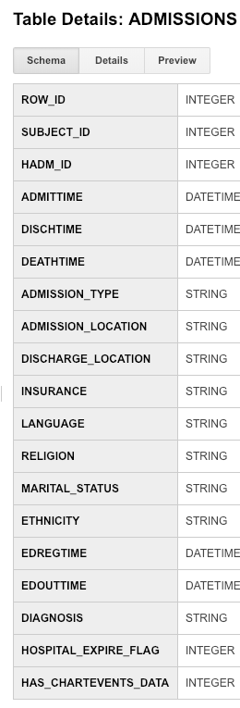
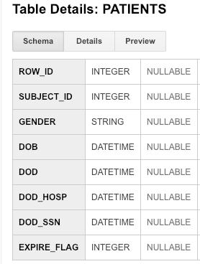
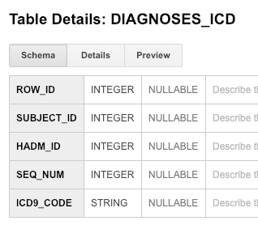
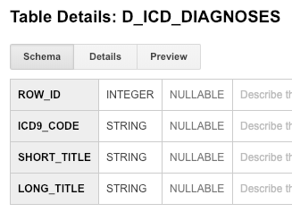
Step 1: Understand source/target data models
Paste one or more MIMIC table(s) from the previous two slides that contain data for ETL into OMOP CONDITION_OCCURRENCE here!
DIAGNOSES field in ADMISSIONS table will not be used because: “Free text diagnosis. Final diagnosis coded on discharge, can be found on DIAGNOSES_ICD table”
Notes:
Paste into one or more slides, the key table or tables from MIMIC that hold data that can be used to fill in the OMOP CONDITION_OCCURRENCE table.
Choose the MIMIC table screenshots from this slide to indicate which MIMIC table or tables would be used in the ETL process. Delete the MIMIC tables that you will not use.

Slide 16
Step 2: Profile source table or tables
Using the White Rabbit profiling data from the 100 patient MIMIC database provided in the Assessment to comment on the distribution of the SUBJECT_ID field from one of the MIMIC tables selected in Step 1
MIMIC TableName
See rubric for the types of topics to include here
Table Field Type Max length N rows N rows checked Fraction empty
ADMISSIONS.csv SUBJECT_ID int 5 -1 129 0
ADMISSIONS.csv DIAGNOSIS varchar 116 -1 129 0
CPTEVENTS.csv SUBJECT_ID int 5 -1 1579 0
DIAGNOSES_ICD.csv SUBJECT_ID int 5 -1 1761 0
DIAGNOSES_ICD.csv ICD9_CODE varchar 5 -1 1761 0
D_ICD_DIAGNOSES.csv ICD9_CODE varchar 5 -1 14567 0
ICUSTAYS.csv SUBJECT_ID int 5 -1 136 0
LABEVENTS.csv SUBJECT_ID int 5 -1 76074 0
PATIENTS.csv SUBJECT_ID int 5 -1 100 0
PRESCRIPTIONS.csv SUBJECT_ID int 5 -1 10398 0
PROCEDUREEVENTS_MV.csv SUBJECT_ID int 5 -1 753 0
PROCEDURES_ICD.csv SUBJECT_ID int 5 -1 506 0
PROCEDURES_ICD.csv ICD9_CODE int 4 -1 506 0
Notes:
Use the White Rabbit data profiling Excel spreadsheet that is linked to the assignment to describe key profiling findings from the table or tables you identified in ETL Step 1. See rubric for the types of topics to include here.

Slide 17
Step 2: Profile source table or tables
Using the White Rabbit profiling data from the 100 patient MIMIC database provided in the Assessment to comment on the distribution of the SUBJECT_ID field from one of the MIMIC tables selected in Step 1
MIMIC PATIENTS table
Table Field Type Max length N rows N rows checked Fraction empty
PATIENTS.csv SUBJECT_ID int 5 -1 100 0
According to MIMIC documentation, “SUBJECT_ID is a unique identifier which specifies an individual patient.”
In this profiling data, there are 100 unique SUBJECT_IDs that identify 100 unique patients.
The data type for the SUBJECT_ID field is INTEGER with a MAXIMUM LENGHT of FIVE CHARACTERS.
There are 100 rows, each row contains the data of a unique patient.
Fraction empty equal to ZERO means that there is no missing data for the SUBJECT_ID field.
Notes:
Use the White Rabbit data profiling Excel spreadsheet that is linked to the assignment to describe key profiling findings from the table or tables you identified in ETL Step 1. See rubric for the types of topics to include here.

Slide 18
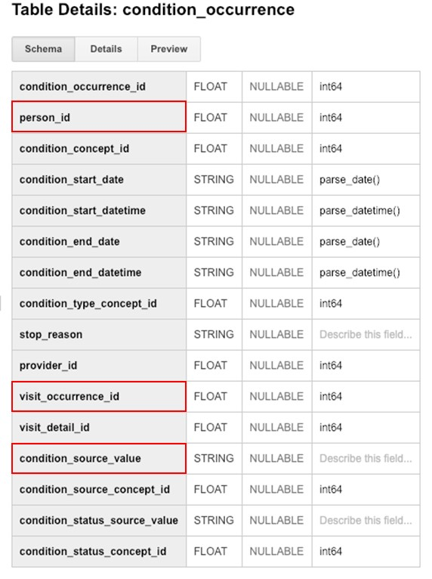
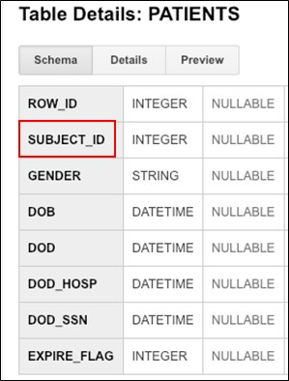
Step 3: Create ETL mappings
subject_id and person_id identify every unique patient in the database.
Notes:
For each MIMIC table or tables (one table per slide) from Step 1, paste the screenshot of the MIMIC table on left side. Show field mappings from the MIMIC table to the OMOP CONDITION_OCCURRENCE table using arrows. Only provide mappings to the OMOP person_id, visit_occurrence_id, and condition_source_value. One MIMIC table may provide a mapping to all three OMOP tables as shown here.
Provide an explanation for each mapping why the MIMIC field relates to the OMOP field you selected on the slide

Slide 19
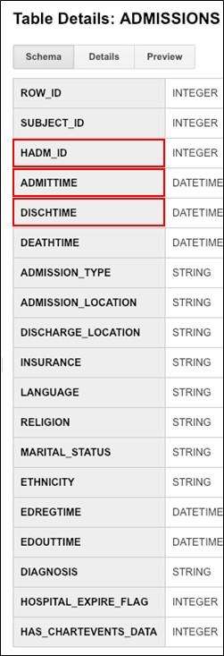
Step 3: Create ETL mappings
MIMICIII documentation:
HADM_ID “represents a single patient’s admission to the hospital.”
ADMITTIME “provides the date and time the patient was admitted to the hospital.”
DISCHTIME “provides the date and time the patient was discharged from the hospital.”
OMOP documentation:
visit_occurrence_id is “the visit during which the condition occurred”
According to ETL Conventions: “Depending on the structure of the source data, this may have to be determined based on dates. If a CONDITION_START_DATE occurs within the start and end date of a Visit it is a valid ETL choice to choose the VISIT_OCCURRENCE_ID from the Visit that subsumes it, even if not explicitly stated in the data”.
Notes:
For each MIMIC table or tables (one table per slide) from Step 1, paste the screenshot of the MIMIC table on left side. Show field mappings from the MIMIC table to the OMOP CONDITION_OCCURRENCE table using arrows. Only provide mappings to the OMOP person_id, visit_occurrence_id, and condition_source_value. One MIMIC table may provide a mapping to all three OMOP tables as shown here.
Provide an explanation for each mapping why the MIMIC field relates to the OMOP field you selected on the slide

Slide 20
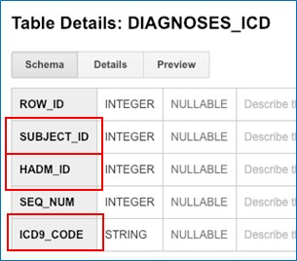
Step 3: Create ETL mappings
DIAGNOSES_ICD: “Hospital assigned diagnoses, coded using the International Statistical Classification of Diseases and Related Health Problems (ICD) system.”
SUBJECT_ID and person_id identify every unique patient in the database.
MIMICIII documentation: HADM_ID “represents a single patient’s admission to the hospital.”
OMOP documentation: visit_occurrence_id is “the visit during which the condition occurred.”
MIMICIII documentation:
“ICD9_CODE contains the actual code corresponding to the diagnosis assigned to the patient for the given row. Note that all codes, as of MIMIC-III v1.0, are ICD-9 codes.
Notes:
For each MIMIC table or tables (one table per slide) from Step 1, paste the screenshot of the MIMIC table on left side. Show field mappings from the MIMIC table to the OMOP CONDITION_OCCURRENCE table using arrows. Only provide mappings to the OMOP person_id, visit_occurrence_id, and condition_source_value. One MIMIC table may provide a mapping to all three OMOP tables as shown here.
Provide an explanation for each mapping why the MIMIC field relates to the OMOP field you selected on the slide

Slide 21
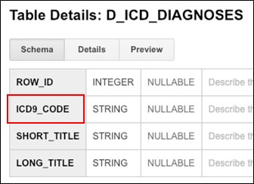
Step 3: Create ETL mappings
From MIMICIII documentation: D_ICD_DIAGNOSES is the “Dictionary of International Statistical Classification of Diseases and Related Health Problems (ICD) codes relating to diagnoses.”
From OMOP documentation: The condition_source_value
contains “the verbatim value from the source data representing the condition that occurred”. According to ETL Conventions: “This code is mapped to a Standard Condition Concept in the Standardized Vocabularies and the original code is stored here for reference.”
Notes:
For each MIMIC table or tables (one table per slide) from Step 1, paste the screenshot of the MIMIC table on left side. Show field mappings from the MIMIC table to the OMOP CONDITION_OCCURRENCE table using arrows. Only provide mappings to the OMOP person_id, visit_occurrence_id, and condition_source_value. One MIMIC table may provide a mapping to all three OMOP tables as shown here.
Provide an explanation for each mapping why the MIMIC field relates to the OMOP field you selected on the slide

Slide 22
Step 4: Write transformation code
Paste the SQL statements that transform data from one or more MIMIC tables into the three OMOP CONDITION_OCCURRENCE fields (patient-id, visit_occurrence_id, condition_source_value) into the Coursera Submission Site
Mapping SUBJECT_ID field from MIMIC-III PATIENTS table to person_id field in OMOP CONDITION_OCCURRENCE table
CODE:
update omop.condition_occurrence op
set op.person_id = mp.subject_id
from mimic.patients mp
Notes:
Paste the SQL statements that transform data in one or more MIMIC tables to the correct column or columns in OMOP CONDITION_OCCURRENCE into the Coursera Submission Site.

Slide 23
Step 4: Write transformation code
Paste the SQL statements that transform data from one or more MIMIC tables into the three OMOP CONDITION_OCCURRENCE fields (patient-id, visit_occurrence_id, condition_source_value) into the Coursera Submission Site
Mapping HADM_ID field from MIMIC-III ADMISSIONS table to visit_occurrence_id field in OMOP CONDITION_OCCURRENCE table
CODE
update omop.condition_occurrence op
set op.visit_occurrence_id = mp.HADM_ID
from mimic.ADMISSIONS mp
Notes:
Paste the SQL statements that transform data in one or more MIMIC tables to the correct column or columns in OMOP CONDITION_OCCURRENCE into the Coursera Submission Site.

Slide 24
Step 4: Write transformation code
Paste the SQL statements that transform data from one or more MIMIC tables into the three OMOP CONDITION_OCCURRENCE fields (patient-id, visit_occurrence_id, condition_source_value) into the Coursera Submission Site
Mapping SUBJECT_ID, HADM_ID, ICD9_CODE fields from MIMIC-III DIAGNOSES_ICD table to
person_id, visit_occurrence_id, condition_source_value fields in OMOP CONDITION_OCCURRENCE table
CODE
update omop.condition_occurrence op
set op.person_id = mp.SUBJECT_ID,
set op.visit_occurrence_id = mp.HADM_ID,
set op.condition_source_value = mp.ICD9_CODE,
from mimic.DIAGNOSES_ICD mp
Notes:
Paste the SQL statements that transform data in one or more MIMIC tables to the correct column or columns in OMOP CONDITION_OCCURRENCE into the Coursera Submission Site.

Slide 25
Step 4: Write transformation code
Paste the SQL statements that transform data from one or more MIMIC tables into the three OMOP CONDITION_OCCURRENCE fields (patient-id, visit_occurrence_id, condition_source_value) into the Coursera Submission Site
Mapping ICD9_CODE field from MIMIC-III D_ICD_DIAGNOSES table to condition_source_value field in OMOP CONDITION_OCCURRENCE table
CODE
update omop.condition_occurrence op
set op.condition_source_value = mp.ICD9_CODE
from mimic.D_ICD_DIAGNOSES mp
Notes:
Paste the SQL statements that transform data in one or more MIMIC tables to the correct column or columns in OMOP CONDITION_OCCURRENCE into the Coursera Submission Site.

Slide 26
Step 5: Execute transformation code
Execute the ETL code from Step 4 but do not submit the output table.
Use the output table for Step 6.
There is no submission for this Step.
Notes:
Execute the ETL code from Step 4 but do not submit output table. Use output table for Step 6.
There is no submission for this Step.

Slide 27
Step 6: Perform data quality assessment
Define, implement, execute one or more data quality measures.
Submit final DQ measure and an explanation why you created your measure(s).
I do not know how to perform this step.
Notes:
Paste the output from your data quality SQL executed on the OMOP CONDITION_OCCURRENCE table generated in Step 5 into this slide.
OK to paste link to a GoogleDoc instead.

Slide 28
Step 7: Package documentation
Congratulations! The materials in the previous slides constitute a complete ETL package.
There is no submission for this Step.

